Slide 1
Time Series Classification under Different Types of Noise
Student: Aonghus Condren
Moderator: Thach Le Nguyen
Supervisor: Georgiana Ifrim

Slide 2
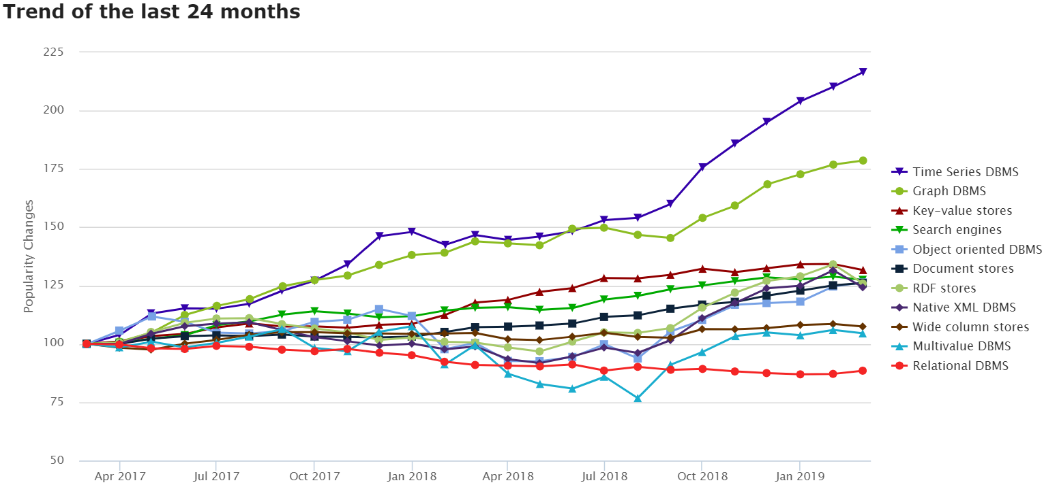
Why Noise in Time Series?
Time Series datasets are becoming increasingly popular (e.g., weather forecasting, financial trading, medical imaging) https://db-engines.com/en/ranking_categories
Sensor data seeing an explosion, sensors are everywhere (phones, cars, factories, satellites, soil)
Time series classification is an important problem (e.g., classify human movement signal into normal/abnormal)
Real world data is noisy (e.g., signal misaligned, external interference)

Slide 3
Related Works
[1] The BOSS is concerned with time series classiﬁcation in the presence of noise, Schaeffer et al, DMKD.(2015)
  Applies noise reduction to the data.
  Gaussian noise was introduced to test invariance to noise.
[2] Fast Similarity Search in the Presence of Noise, Scaling, and Translation in Time-Series Databases, VLDB.(1997)
  New classification model introduced, with a key feature of ignoring noise when matching sub-sequences.
  Amplitude Scaling and Offset Translation noise used.
These works highlight common noise types found in time series data.

Slide 4
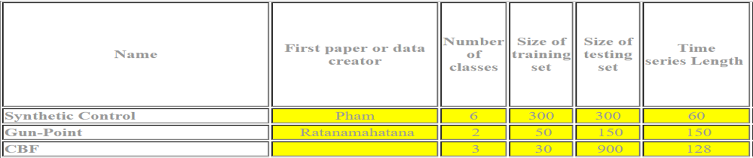
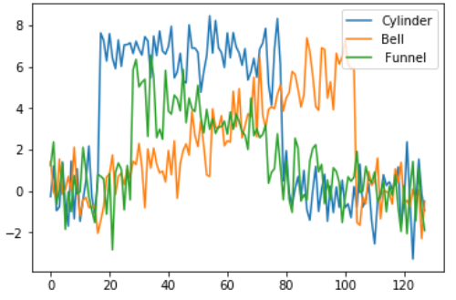
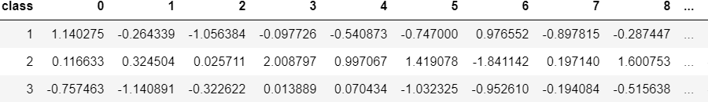
The Data
UCR Time series Classification archive
  Used widely in the creation of
  new classification methods.
CBF Dataset:
  Synthetic dataset with 3 classes.
  Code available to modify/generate
  dataset.

Slide 5
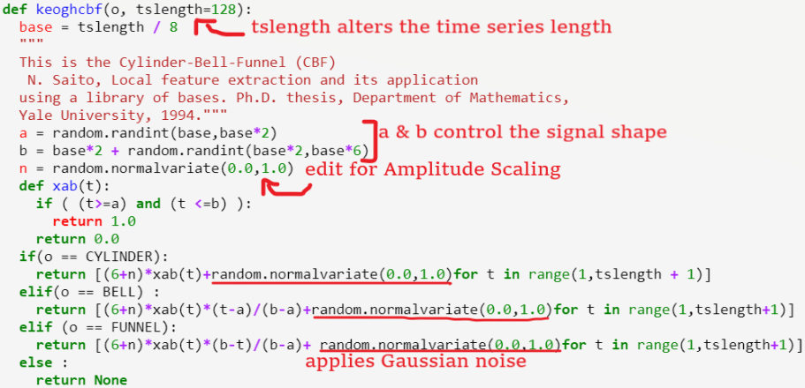
Generating Noisy Datasets from Base Code
We examine 4 distinct types of noise on our data:
  Variable Length TS
    tslength controls length of the time series
  Signal Shape Time Warping
    a & b control signal shape.
  Amplitude Scaling
    n controls amplitude of signal shape.
  Gaussian Noise
    applied to all classes of time series.
We apply noise to 20%, 40% and 60% of the data.

Slide 6
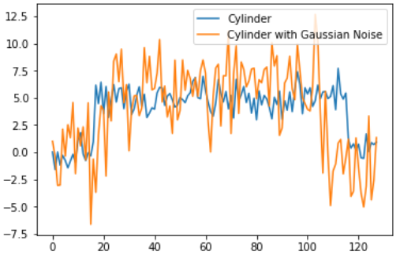
Generating and Visualizing our Data
Noise is applied to all signal shapes.
Split data into testing and training datasets
Gaussian Noise example: baseline
time series vs noise injection

Slide 7
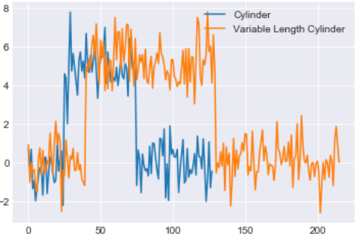
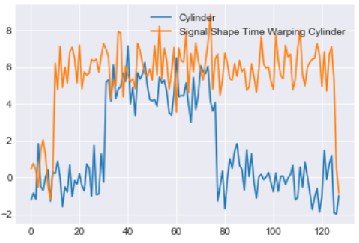
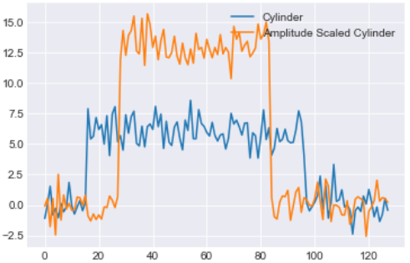
Generating our Data
Distinct changes to the signal shapes for each noise type.

Slide 8
Time Series Classification Methods
We examine 5 different state of the art classification models:
Dynamic Time Warping (DTW)
  Simple yet highly competitive method.
Fully convolutional networks (FCN)
  Deep learning classification method.
The following are symbolic methods, with distinct symbolic representations:
Word Extraction for Time Series Classification (WEASEL)
Bag of Symbolic-Fourier-Approximation symbols (BOSS).
Linear models + symbolic representations (Mr-SEQL).

Slide 9
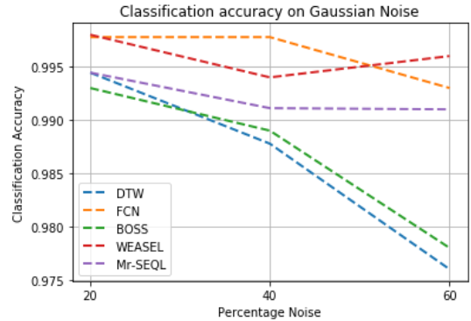
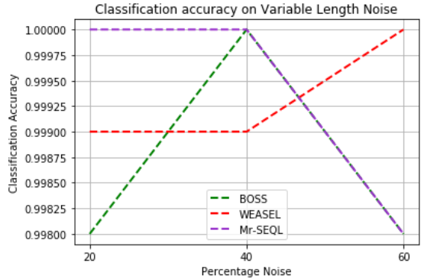
Results Visualized
DTW and FCN classification methods are unable to classify variable length noise.
  VL noise handled well, when accounted for by the other methods.
Classifiers react differently to noise types.

Slide 10
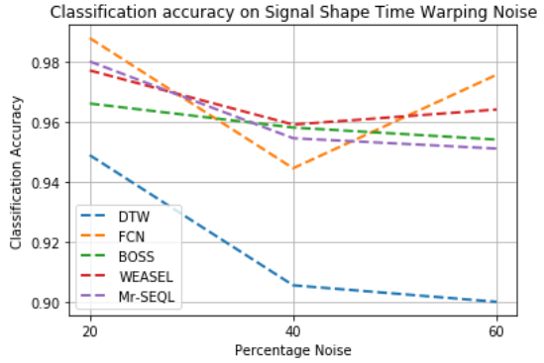
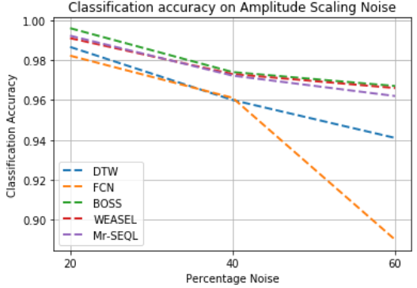
Results Visualized
Deep learning method struggles with Amplitude noise
All but DTW classification, see only slight accuracy degradation on signal shape time warping.

Slide 11
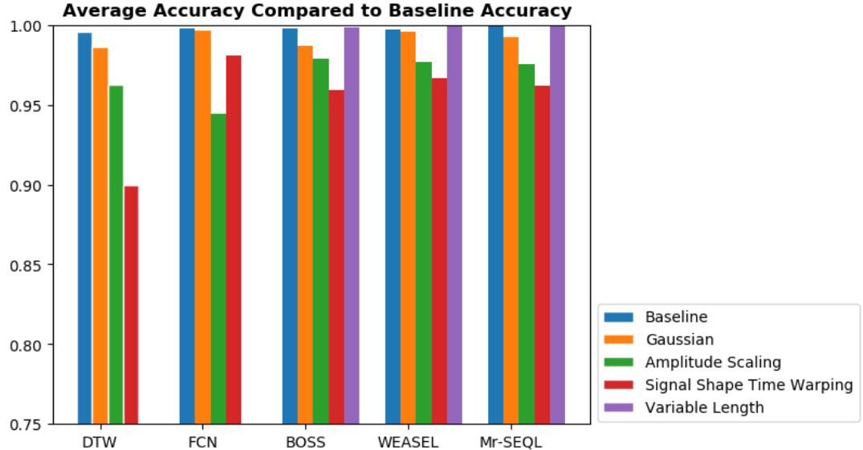
Conclusion
Noisy data has an adverse effect on the accuracy of TS classifiers
No one classifier is immune to all types of noise.
Some noise is easier to handle.
Average accuracy across all noise percentiles gives indication of how each classifier handles different noise.

Slide 12

Future Work
Working with real world data.
  The data used was all generated to simulate real world data, so the next step would be gathering sensor data to examine.
Include missing data as a type of noise to be examined.
  Common with time series data.

Slide 13
References
Agrawal, R.(1997). Fast Similarity Search in the Presence of Noise, Scaling, and Translation in Time-Series Databases
Bagnall. (2017). Bagnall A, The great time series classiﬁcation bake oﬀ: a review and experimental evaluation of recent algorithmic advances.
Hassan I F et al. (2018). Deep learning for time series classiﬁcation: a review.
Schäfer, P. (2015). The BOSS is concerned with time series classification in the presence of noise.
Schäfer, P. et al. (2017). Fast and Accurate Time Series Classification with WEASEL.
Le Nguyen, T. et al.(2018) Interpretable Time Series Classification using All-Subsequence Learning and Symbolic Representations in Time and Frequency Domains
https://db-engines.com/en/ranking_categories

